Slide 1
Probability & STATistics
Permutations & combinations

Slide 2
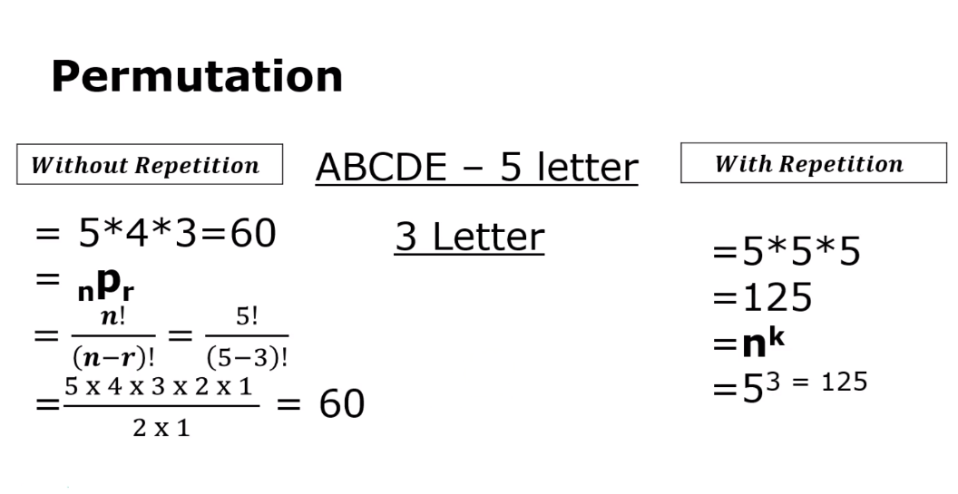

Slide 3
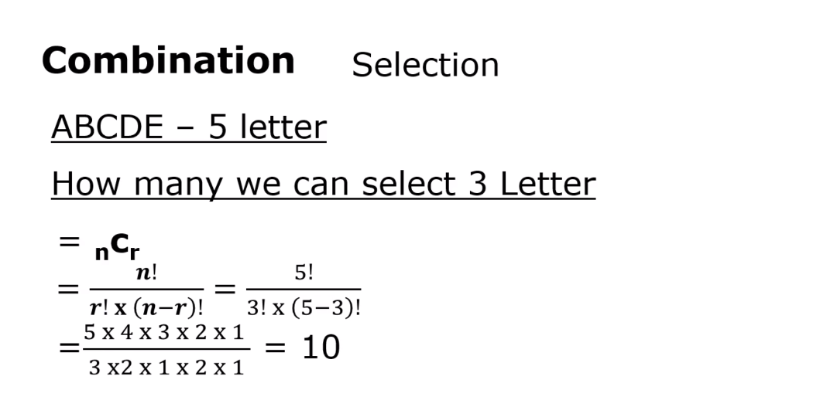

Slide 4
What is Probability? Probability is the chance that something will happen - how likely it is that some event will happen. Sometimes you can measure a probability with a number like "10% chance of rain", or you can use words such as impossible, unlikely, possible, even chance, likely and certain.
Example: "It is unlikely to rain tomorrow".

Slide 5
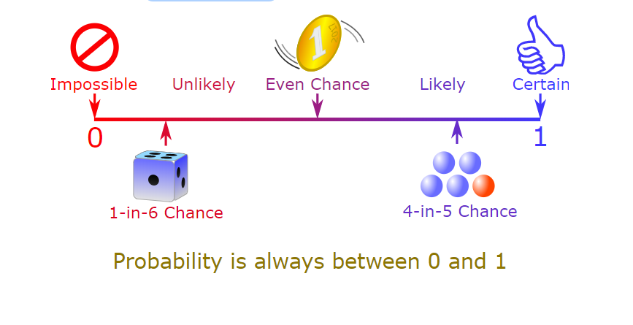

Slide 6
Exhaustive Events: The total number of all possible elementary outcomes in a random experiment is known as ‘exhaustive events’. In other words, a set is said to be exhaustive, when no other possibilities exists.
Favorable Events: The elementary outcomes which entail or favor the happening of an event is known as ‘favorable events’ i.e., the outcomes which help in the occurrence of that event.

Slide 7
Mutually Exclusive Events: Events are said to be ‘mutually exclusive’ if the occurrence of an event totally prevents occurrence of all other events in a trial. In other words, two events A and B cannot occur simultaneously.

Slide 8
Equally likely or Equi-probable Events: Outcomes are said to be ‘equally likely’ if there is no reason to expect one outcome to occur in preference to another. i.e., among all exhaustive outcomes, each of them has equal chance of occurrence.
Complementary Events: Let E denote occurrence of event. The complement of E denotes the non occurrence of event E. Complement of E is denoted by ‘Ē’.

Slide 9
Bayes’ theorem
Conditional probability

Slide 10
Independent Events: Two or more events are said to be ‘independent’, in a series of a trials if the outcome of one event is does not affect the outcome of the other event or vise versa

Slide 11
Certain event:
Sun rises in the east
P(E)=1
Impossible event:
Sun rises in the west
P(E)=0

Slide 12
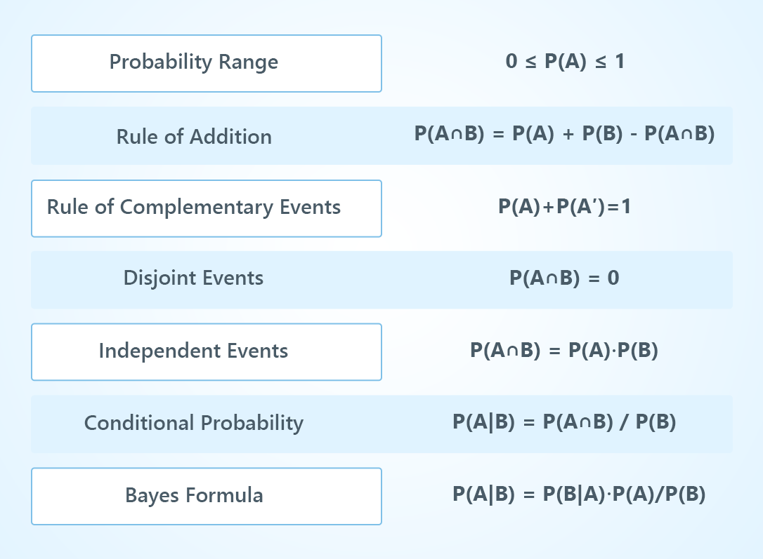

Slide 13
Probability varies between 0 and 1
The sum of the probabilities of all outcomes must equal 1
The probability that an event does not occur is 1 minus the probability that the event does occur.

Slide 14
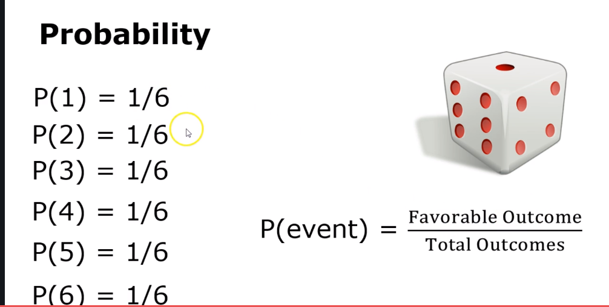

Slide 15
Union, intersection, complement of event
Dependent event & independent event.

Slide 16
Alice has two children, what are the chances, if one of the children is a girl, that both children are girls?
If you roll a fair sided die twice, what is the probability of getting atleast one 5.

